Slide 1

Ethics Game
Neeharika Kasarla
Sai Rama Krishna Tummala
Ben Shelton
Daniel Bowen

Slide 2
Introduction
The main aim of this game design is to create an environment in which a student can learn Software Engineering Ethics in a recreational way.

Slide 3
Description
3 levels of difficulty
Easy
Medium
Hard
in which each level starts with mini game followed by ethics game questions.

Slide 4
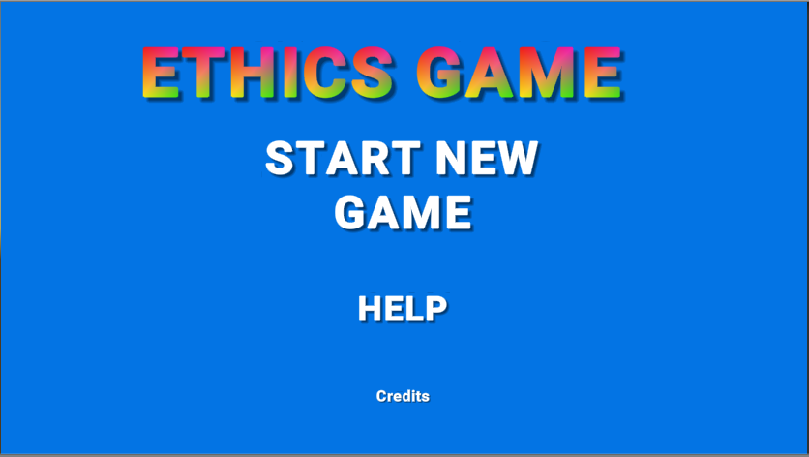
Start Screen
Exit

Slide 5
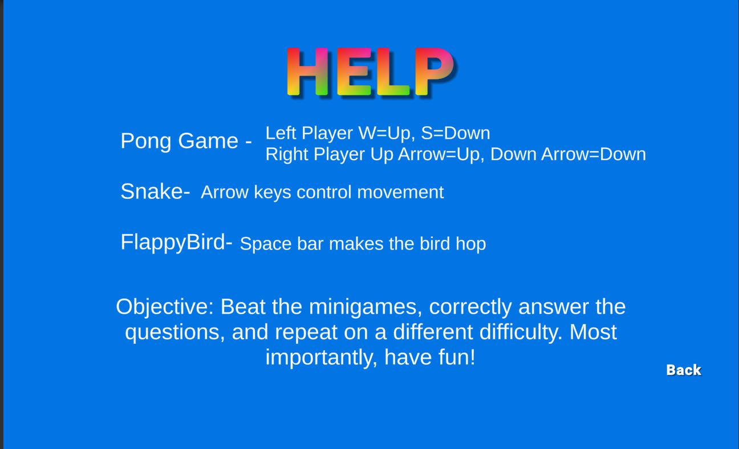
Help Screen

Slide 6
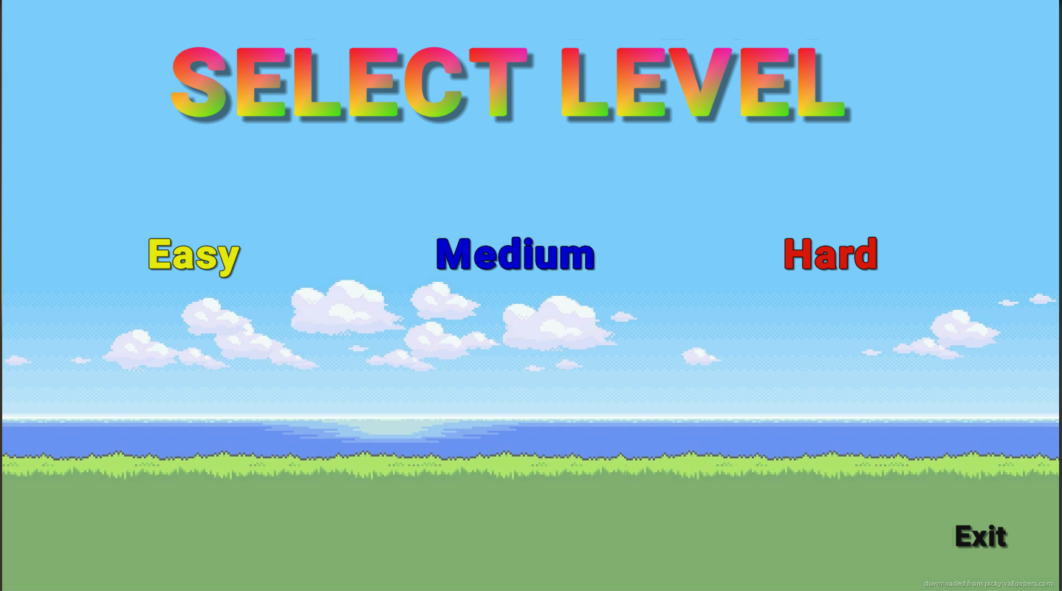
Level Select Screen

Slide 7
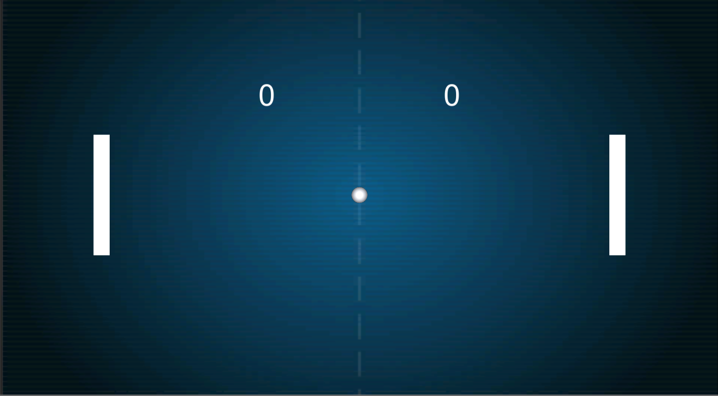
Pong - Mini Game 1

Slide 8
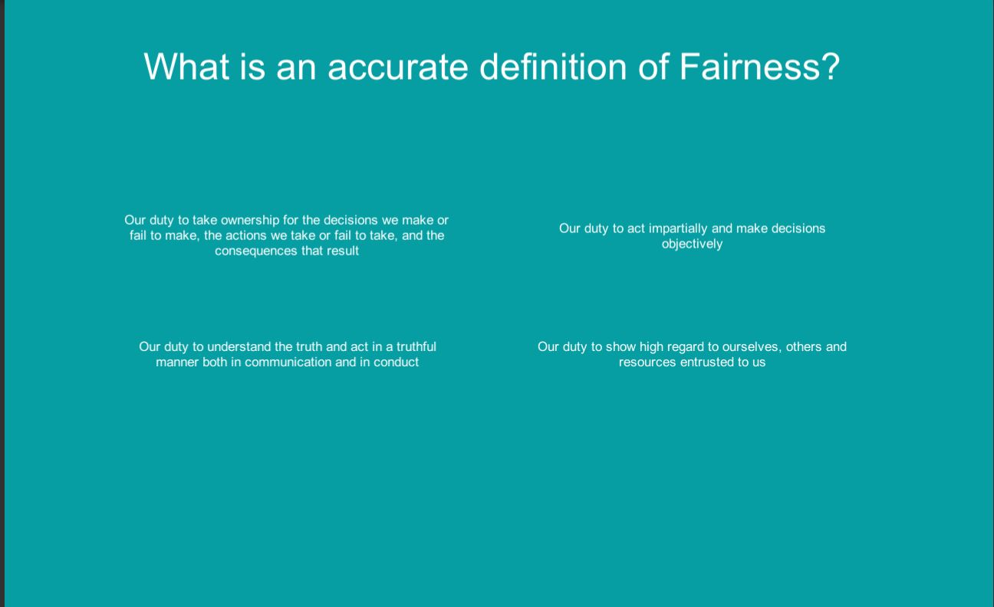
Question Screen

Slide 9

Snake - Mini game 2

Slide 10
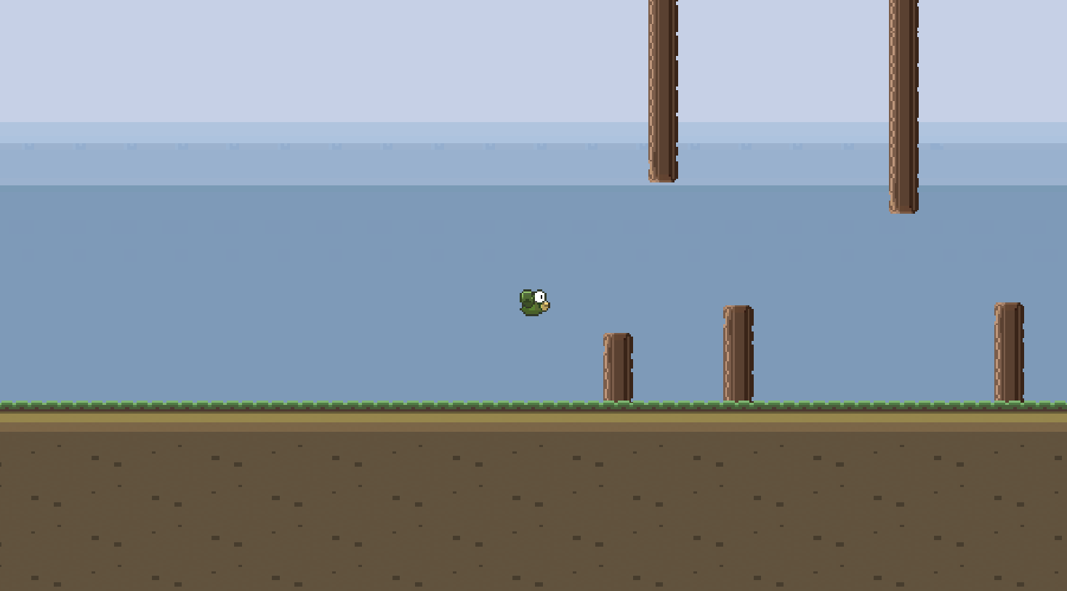
Flappy Bird - Mini game 3

Slide 11

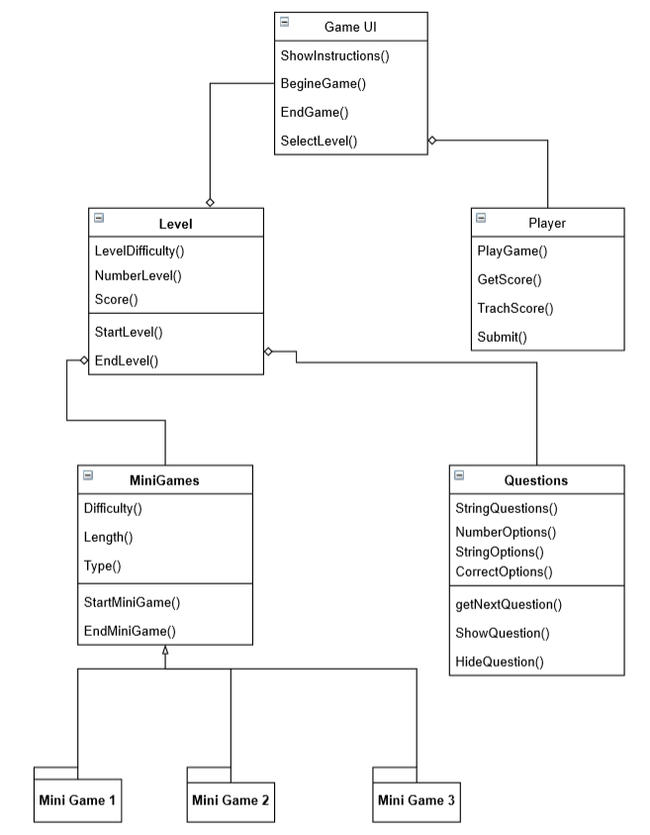

Slide 12
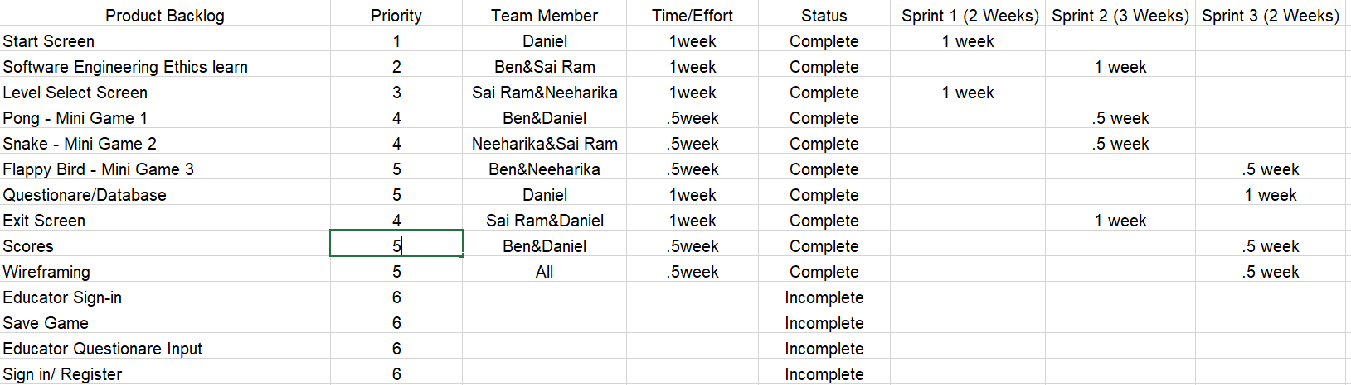
Product Backlog

Slide 13
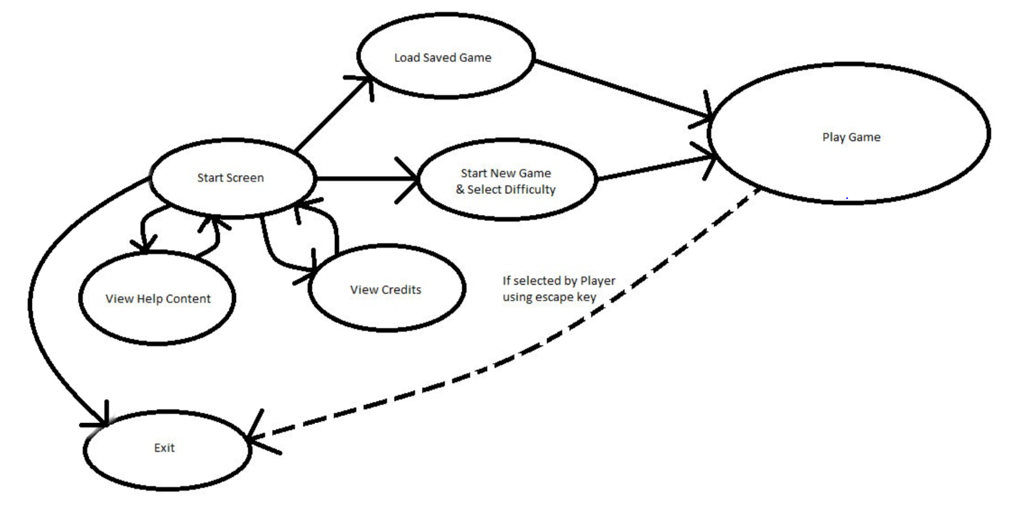
Navigation Diagram

Slide 14

Live Demonstration

Slide 15
Compromises
Difficulties not as robust as planned
Small question pool
Pong opponent should be AI
Missing sound effects from mini-games
Education before questions

Slide 16
Questions?

